Slide 1
Logic and Persistence Development
Lecturer: Ngo Huy Bien
Software Engineering Department
Faculty of Information Technology
VNUHCM - University of Science
Ho Chi Minh City, Vietnam
nhbien@fit.hcmus.edu.vn

Slide 2
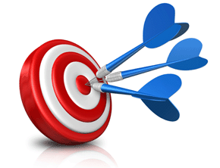
Objectives
To implement a persistence layer
To implement a logic layer
To create a routine using PPP
To create a routine using TDD

Slide 3

Contents
Persistence Layer
Logic Layer
Pseudo-Code Programming Process
Test-Driven Development

Slide 4

References
Steve McConnell (2004). Code Complete. Microsoft Press.
Kent Beck (2002). Test Driven Development By Example. Addison Wesley.
Gerard Meszaros (2007). xUnit Test Patterns Refactoring Test Code.

Slide 5
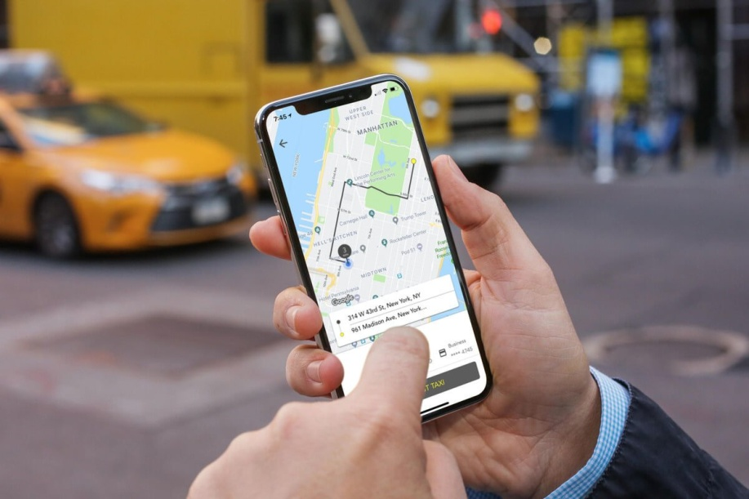
1. Identify UI Inputs and Outputs
Use primitives or data structure or object view model to represent UI inputs and outputs.

Slide 6
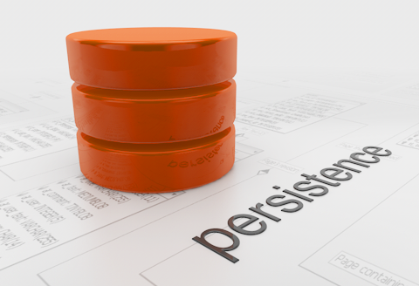
2. Select the Storage Type
Common options include
file storage,
relational databases,
NoSQL databases,
graph databases, and
vector databases, including cloud-based options.

Slide 7
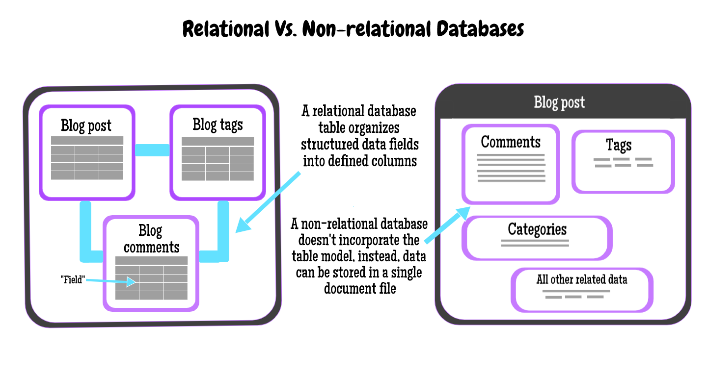
3. Create Data Schema and SQL Scripts
A (problem) domain model may be useful for this task.
Initial data may be imported into the database.

Slide 8
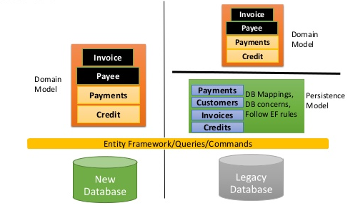
4. Select a Persistence Framework or Library
Common options include
low-level data access libraries,
ORMs (Entity Framework, Hibernate, NHibernate, Fluent Nhibernate), or
cloud SDKs.

Slide 9
5. Create Persistence Code
Data Model
Persistence Frameworks/Libraries
Persistence Code
Create data transfer objects.
Create persistence objects.
Create unit tests.
Ensure ACID properties.

Slide 10


Slide 11
1. Create Transaction Scripts
How to map UIs or services to functions?
User Stories, UI Design, Use Cases, Problem Domain Model, Static/Dynamic Diagrams
UI Inputs (Parameters): Primitive Types, Data Structures, DTO
UI Outputs (Returned Value): Primitive Types, Data Structures, DTO
Algorithms + Creativity → Transaction Scripts Code (i.e. Functions Code)

Slide 12
2. Or Create a Domain Model
User Stories, UI Design, Use Cases, Problem Domain Model, Static/Dynamic Diagrams
Design Patterns + Domain-Driven Design + Creativity
UI Inputs, UI Outputs: Primitive Types, Data Structures, DTO
Domain Model Code (Persistence Objects, Repositories, Aggregates, Services, Factories, Utilities, Registries)
How to map an UI to a network of objects or functions?

Slide 13
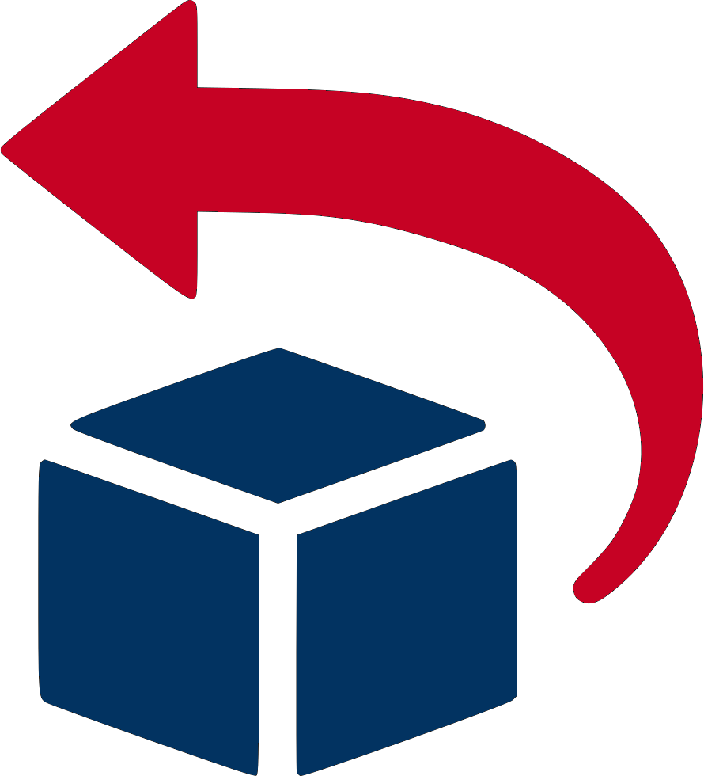
Flexible Process (1→ 4. → 3. → 2.)
1. Identify UI inputs and outputs.
4. Create transaction scripts,
4. Or create a domain model.
3. Implement persistence layer.
2. Create data schema.

Slide 15
Add New Fields to Existing System
Optionally add new controls to UIs.
Optionally add new field to database schema.
Add new properties to domain classes or functions or view models (DTOs).
Add DevOps flag and use it to show/hide UIs related to the new properties.
Retrieve all input values for the new properties.
Modify or create Factory classes or constructors for the new properties, unit tests for the changes.
Modify or create Persistence classes, store procedures, unit tests for the changes.

Slide 16
Add New Screen to Existing System
Optionally add new controls to UIs.
Optionally add new field to database schema.
Add new properties to domain classes or functions or view models (DTOs).
Add DevOps flag and use it to show/hide UIs related to the new properties.
Retrieve all input values for the new properties.
Modify or create Factory classes or constructors for the new properties, unit tests for the changes.
Modify or create Persistence classes, store procedures, unit tests for the changes.

Slide 18
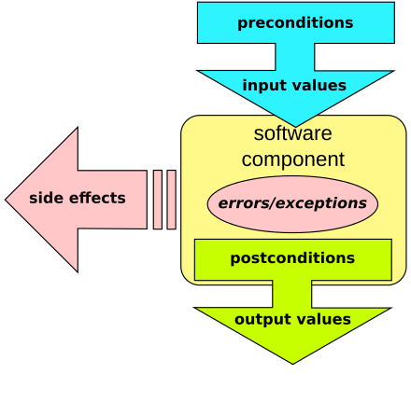
1. Implement Design by Contract
Check related components if necessary.
Validate inputs.
Validate returned values.
Check related components if necessary.

Slide 19
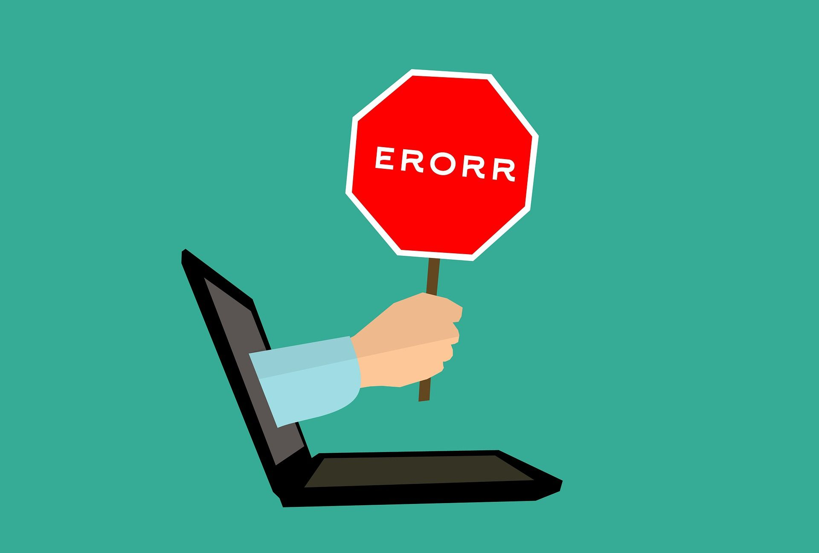
2. Implement Robustness
Try/Catch/Throw
Anticipate and Handle Exception/Log/Return Error/Show Friendly Message/Notify Users.

Slide 20
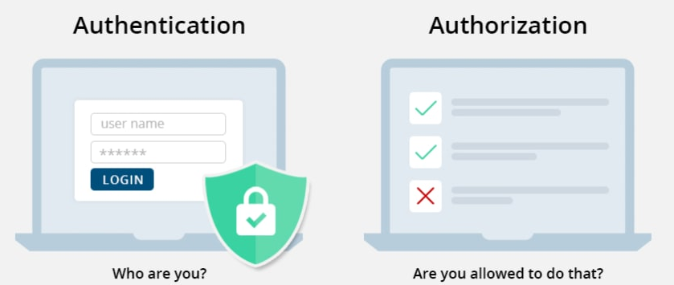
3. Implement Security

Slide 22
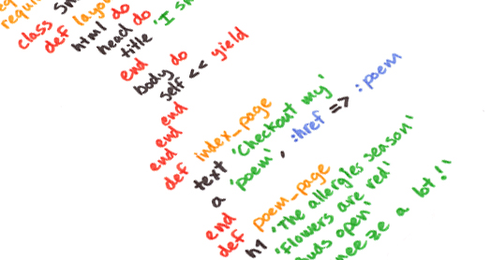
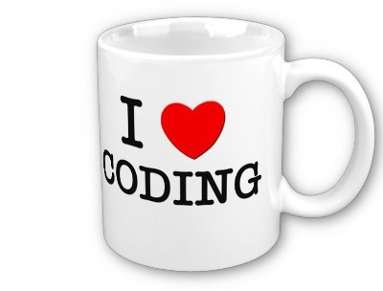
How to Code a Difficult Feature?

Slide 23
Pseudo-Code Programming Process [1]
Business Model
PPP
Business Code
Detailed Design (Class Diagram, Sequence Diagram, Entity Relationship Model, Activity Diagram, Flow Chart…)
Define inputs
Define outputs
Think about algorithms
Write Pseudo Code
Turn Pseudo Code to Real Code
Test Routine

Slide 24
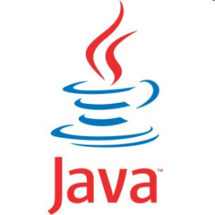
Pseudocode
Pseudocode refers to an informal, English-like notation for describing how an algorithm, a routine, a class, or a program will work.
Keep track of current number of resources in use
If another resource is available
Allocate a dialog box structure
If a dialog box structure could be allocated
Note that one more resource is in use
Initialize the resource
Store the resource number at the location provided by the
caller
Endif
Endif
Return true if a new resource was created; else return false
Research functionality available in the standard libraries
Think about error handling
Think about efficiency

Slide 25
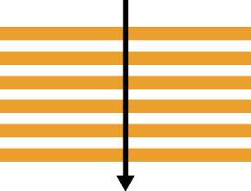
Sequence
A sequence is a set of statements executed in order.
OPEN file READ first record DISPLAY first record

Slide 26
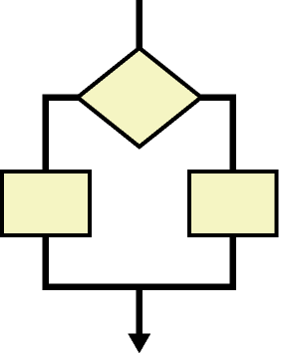
Selection
A selection is a control structure that causes statements to be executed selectively.
IF condition is true THEN
sequence 1
ELSE
sequence 2
ENDIF
CASE expression OF
condition 1 : sequence 1
condition 2 : sequence 2
...
condition n : sequence n
OTHERS:
default sequence
ENDCASE

Slide 27
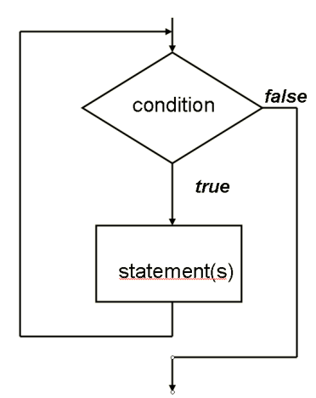
Iteration
An iteration is a control structure that causes a group of statements to be executed multiple times.
WHILE student_total < 50
READ student record
PRINT student name and address
ADD 1 to student_total
ENDWHILE
FOR each month of the year (good)
PRINT days_of_month
ENDFOR

Slide 28
Turn Pseudocode into Real Code
IF Credit Card Number is Valid
THEN
Execute Transaction Based Upon Credit Card Number
and Order Number
ELSE
DISPLAY "Transaction failed"
ENDIF
<?phpif
(is_valid($cc_number))
{
execute_transaction($cc_number, $order);
} else
{
show_failure();
}
?>

Slide 29

Pseudocode Benefits
Pseudocode makes reviews easier.
Pseudocode supports the idea of iterative refinement.
Pseudocode makes changes easier.
Pseudocode minimizes commenting effort.
Pseudocode is easier to maintain than other forms of design documentation.

Slide 31
Fibonacci Example (I) [2]
f(0) = 0
f(1) = 1
f(n) = f(n-1) + f(n-2), n >= 2

Slide 32
Fibonacci Example (II)

Slide 33
Fibonacci Example (III)

Slide 34
Fibonacci Example (IV)
f(0) = 0
f(1) = 1
f(n) = f(n-1) + f(n-2), n >= 2

Slide 35
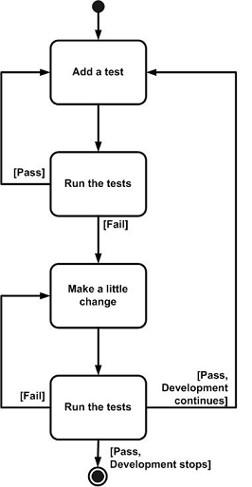
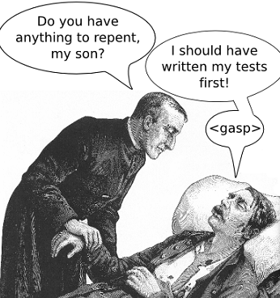
Test-Driven Development
Test-driven development is an evolutionary approach to development which combines test-first development where you write a test before you write just enough production code to fulfill that test and refactoring.
red-green-refactor

Slide 36
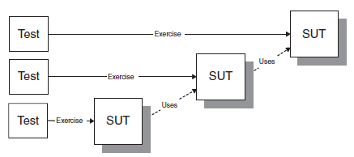

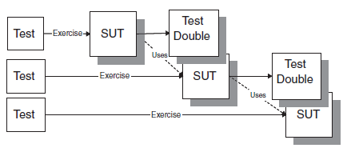
Inside-Out and Outside-In [3]
Avoid dealing with the “dependency problem.”
Clarify which tests are needed for the
next layer inward.

Slide 37
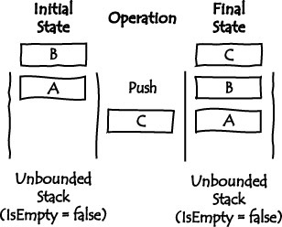
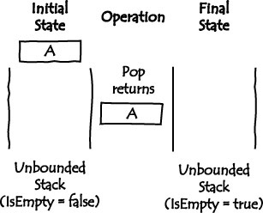
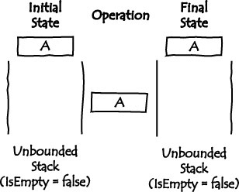
The Task aka Requirements
Implement an unbounded Stack, which is a data structure in which access is restricted to the most recently inserted item.
The operations include Push, Pop, Top, and IsEmpty.

Slide 38
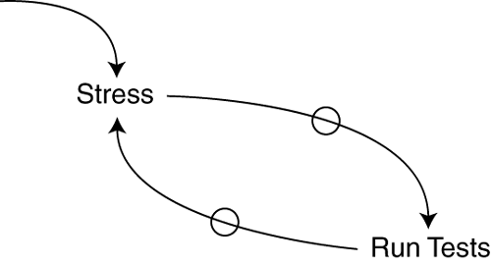
Test (noun) [2] (HOW)
How do you test your software?
Write an automated test.
A test (noun) is a procedure leading to acceptance or rejection.
With automated tests, when I start to feel stress, I run the tests.

Slide 39
Test List (WHAT)
What should you test?
Before you begin, write a list of all the tests you know you will have to write.
Put on the list examples of every operation that you know you need to implement.
As you make the tests run, the implementation will imply new tests. Write the new tests down on the list.
$5 + 10 CHF = $10 if rate is 2:1
$5 * 2 = $10
Make "amount" private
Dollar side effects?
Money rounding?

Slide 40

Isolated Test and Test Data
How should the running of tests affect one another?
Not at all.
What data do you use for test-first tests?
Use data that makes the tests easy to read and follow.
If there is a difference in the data, then it should be meaningful.
If there isn't a conceptual difference between 1 and 2, use 1.

Slide 41
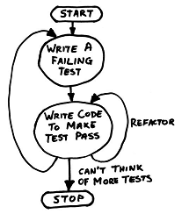
Test First (WHEN)
When should you write your tests?
Before you write the code that is to be tested.
How large should your steps be?
You could write the tests so they each encouraged the addition of a single line of logic and a handful of refactorings.
You could write the tests so they each encouraged the addition of hundreds of lines of logic and hours of refactoring. Which should you do?
You should be able to do either. The tendency of Test-Driven Developers over time is clear, though—smaller steps.

Slide 42
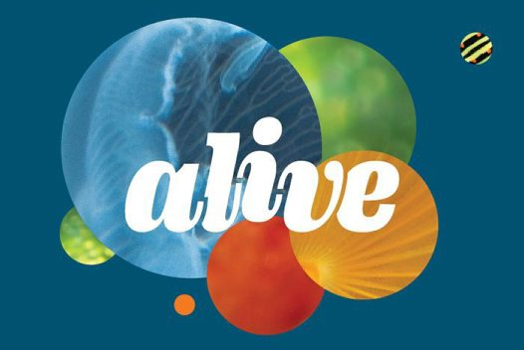

How Much Change is Enough?

Slide 43

Why TDD?
Enables you to take small steps when writing software → easier to develop software
Enable you to design the system.
Enable you to document the system.
The design of the system is inherently testable → less defects
The production code tends to be more minimalist → more productive

Slide 44
TDD vs. Big Upfront Design
“There are two ways of constructing a software design:
One way is to make it so simple that there are obviously no deficiencies,
and the other way is to make it so complicated that there are no obvious deficiencies.
The first method is far more difficult.”
– Sir Charles Antony Richard Hoare

Slide 45
Exercise
class SelectionSort
{
public int[] Sort(int[] array)
{
for (int position = 0;
position < array.Length - 1; position++)
{
int minValueIndex =
this.GetMinValueIndex(array, position);
this.SwapValues(array, minValueIndex, position);
}
return array;
}
}

Slide 47
Loose Coupling
I want the components in my applications to be as independent as possible and to have as few interdependencies as I can arrange.
In an ideal situation, each component knows nothing about any other component and only deals with other areas of the application through abstract interfaces.
Fabian Beck and Stephan Diehl. On the Congruence of Modularity and Code Coupling. 2011.

Slide 48
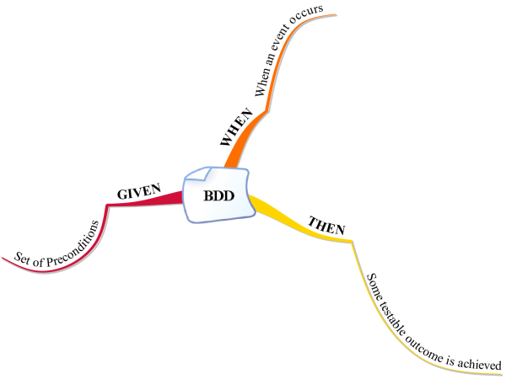
Behaviour-Driven Development
Behaviours are more important than tests!
As a [Role]
I want [Feature]
so that I receive [Value]
Given some initial context (the givens),
When an event occurs,
then ensure some outcomes.
Given the account is in credit
And the card is valid
And the dispenser contains cash
When the customer requests cash
then ensure the account is debited
And ensure cash is dispensed
And ensure the card is returned
+Title: Customer withdraws cash
As a customer,
I want to withdraw cash from an ATM,
so that I don’t have to wait in line at the bank.

Slide 49
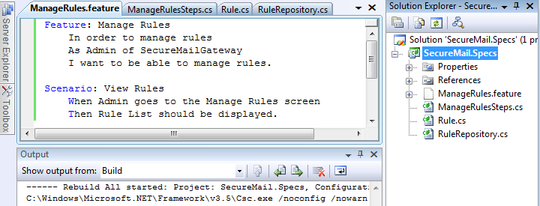
Using BDD
Create story
Create scenarios using the words Given, When, Then
Generate unit tests (using a framework)
Create the code

Slide 50

Thank You & See You Again

